Slide 1
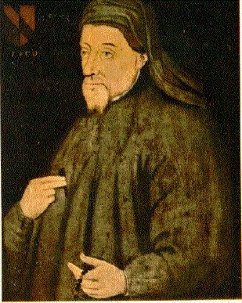
Geoffrey Chaucer & The Canterbury Tales
Famously captures and comments on life in the late Middle Ages
Author of the poem
The Canterbury Tales

Slide 2
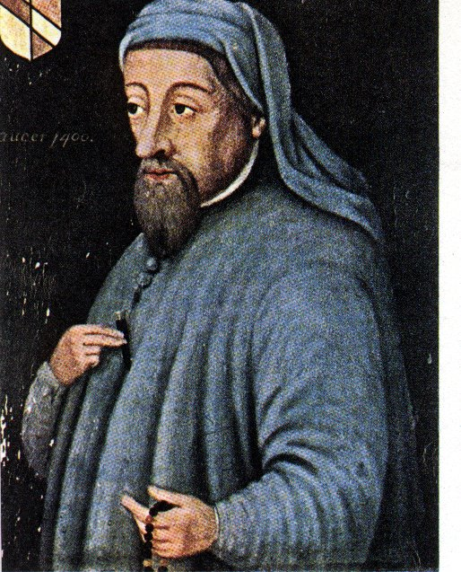
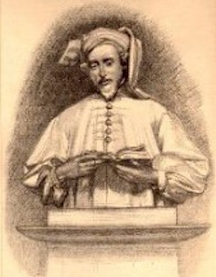
Early Life
Born c. 1340
Son of a prosperous wine merchant (not nobility!)
Served the Countess of Ulster
Served in English Army
Chaucer served the royal household for many years in various jobs
Chaucer’s work experience and travels afforded him with the ability to see people from all levels of society
This exposure allows him to write characters who represent the lower, middle, and upper classes

Slide 3
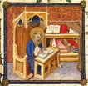
•If you were to do the same thing today, think about the variety of types of people you know and have encountered.
• In The Canterbury Tales, Chaucer writes about a group of people going on a pilgrimage.

Slide 4
Literary Characteristics of The Canterbury Tales
FRAME STORY:
A literary device in which a smaller story is told within the context of the tale
Example: Chaucer is telling the story of the pilgrims; within that, smaller tales are told by each pilgrim

Slide 5
Literary Characteristics, cont’d.
HEROIC COUPLETS:
2 paired lines of poetry, written in iambic pentameter (meter). The pair (or couplet) must RHYME.
Introduced by Chaucer!
Example: “You’re off to Canterbury - well, God speed!/May blessed St. Thomas answer to your need!”

Slide 6
Literary Characteristics, cont’d.
VERBAL IRONY
Is when there is a meaningful contrast between what is said and what is actually meant
Example: Referring to the monk as, “The best monk,” when really the monk does not adhere to the ideals of monastic life

Slide 7
Chaucer described his characters by:
Their job
The type and color of their clothing
Their “accessories” (jewelry, pets, other objects)
The way they act
Their income
Their “secrets”
Their status in society as a whole
The way they speak / their slang or accent
Their mode of transportation (walk, on horse, or on mule)
Direct OR indirect characterization???

Slide 8
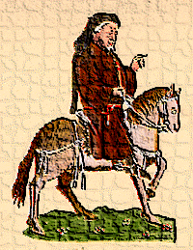
Chaucer’s Plan
A prologue (introduction) followed by a series of stories and linking dialogues and commentaries
Each character would tell 2 stories going and 2 stories coming home
uh… coming home from WHERE?
Canterbury, of course. After all, his work IS called : The Canterbury Tales

Slide 9
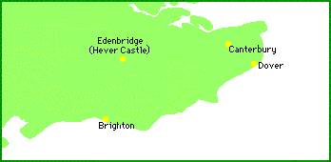
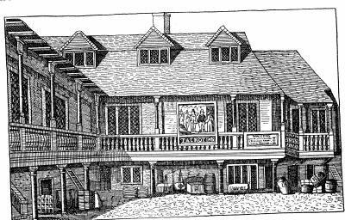
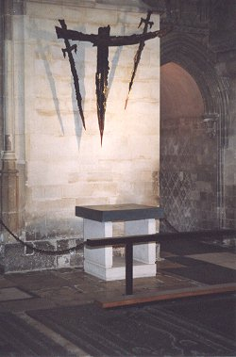
The Tabard Inn
Shrine of Saint Thomas à Beckett
Canterbury Cathedral
London

Slide 10
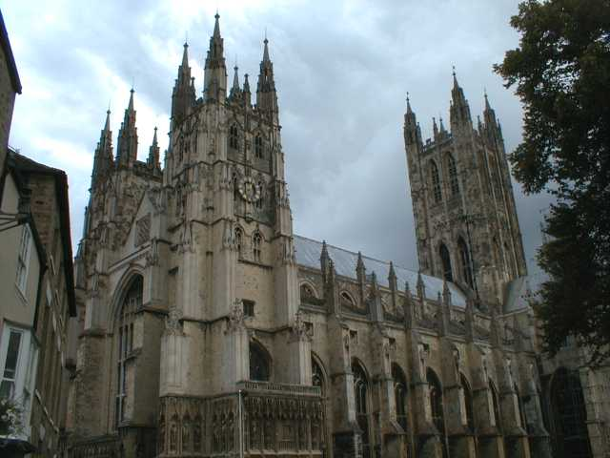
But why go to Canterbury?

Slide 11
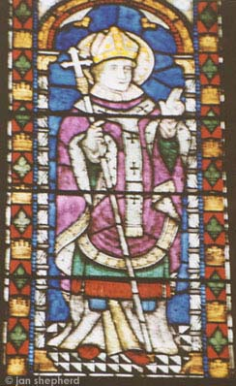
One Answer: Religion
Canterbury has always been an important religious center in England.
St. Augustine (seen in stained glass from the Canterbury Cathedral) was sent by Pope Gregory the Great to establish the Catholic faith in the country
Religion played an important part in medieval life.

Slide 12
Why was religion important?
It’s the Middle Ages
Plague
Warfare
High Infant Mortality Rate
Short Life Expectancy
…and if you were a peasant, you lived your whole life in harsh conditions
About the best thing that you had to look forward to was dying and going to heaven

Slide 13
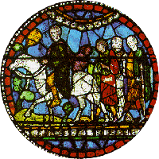
Also, Canterbury was a pilgrimage site
People of all classes went on pilgrimages to holy sites to ask for help with medical, financial or other problems.

Slide 14
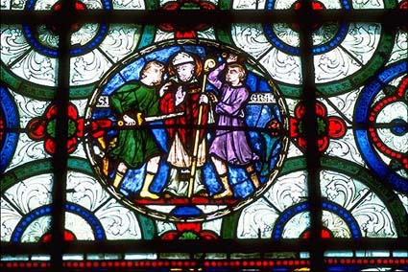
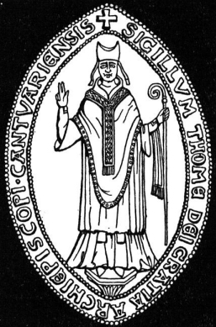
The Shrine of St. Thomas à Becket
Stained glass depicting two knights of King Henry II stabbing Archbishop Thomas à Becket

Slide 15
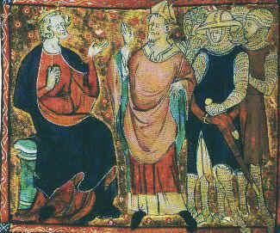
Becket was a trusted adviser and friend of King Henry II. Henry named Becket to be the Archbishop of Canterbury.

Slide 16
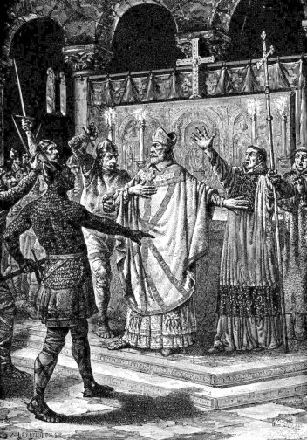
Becket’s outspoken style angered the King. One day, Henry complained, “Will no one rid me of this meddlesome priest?” Three knights rode to Canterbury where they found Becket at the altar of Canterbury Cathedral.

Slide 17
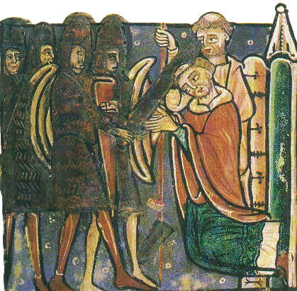
Becket was murdered at the altar.

Slide 18
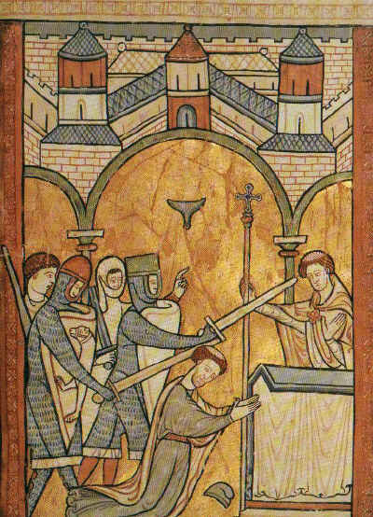
The death of Becket angered the peasants who felt his Saxon heritage made him one of them.

Slide 19
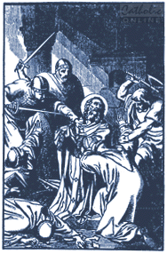
Canterbury Cathedral, thus, became a site for pilgrims to offer prayers to St. Thomas.

Slide 20
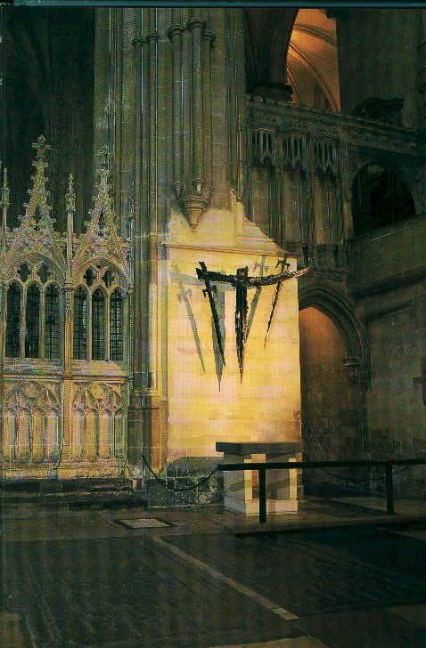
Today, a modern cross made from swords marks the site of the martyrdom.

Slide 21
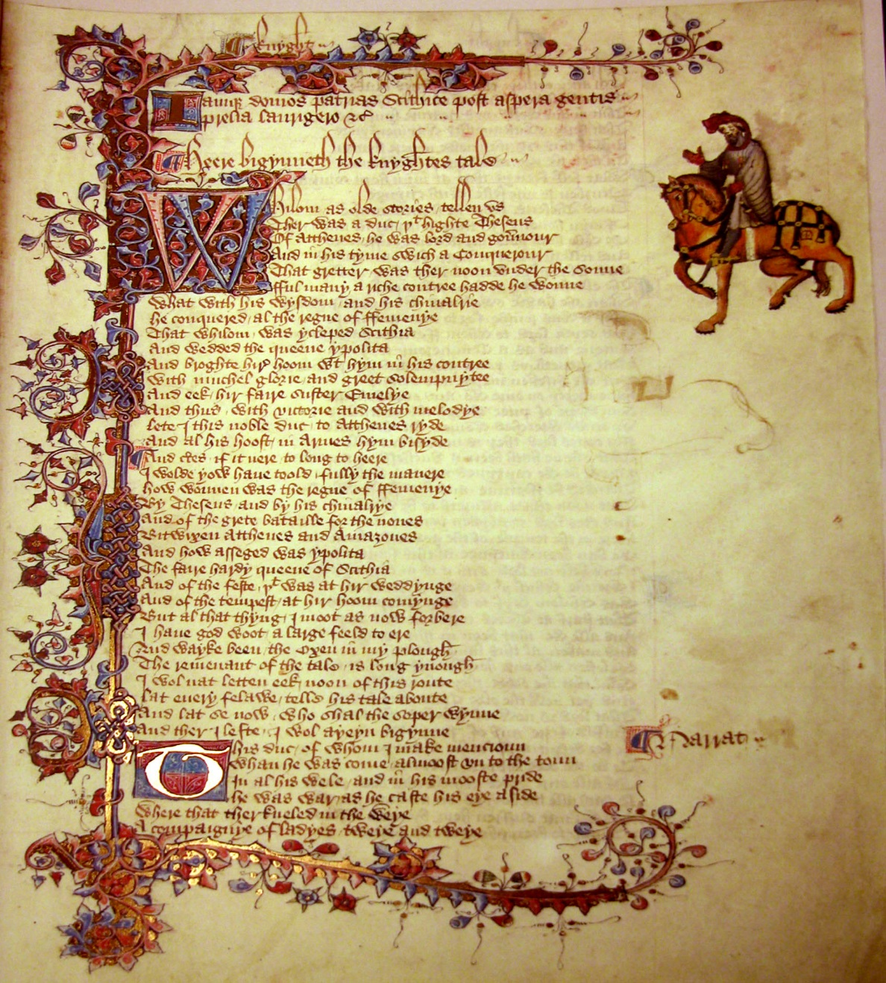
The fact that Chaucer wrote in Middle English (rather than French or Latin like many of his fellow writers), meant that ordinary folk could enjoy The Canterbury Tales and its vivid characters.

Slide 22
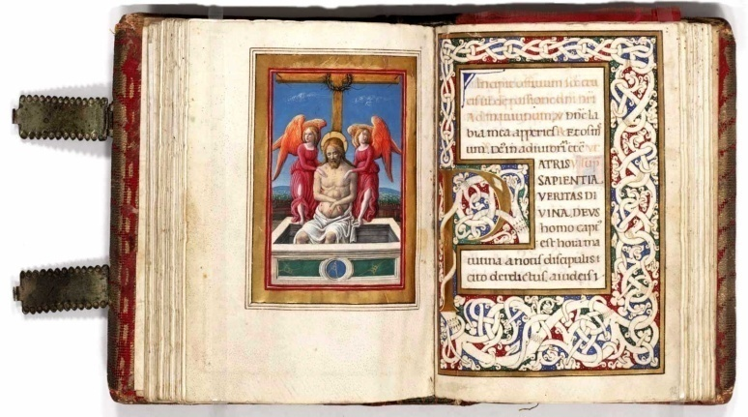
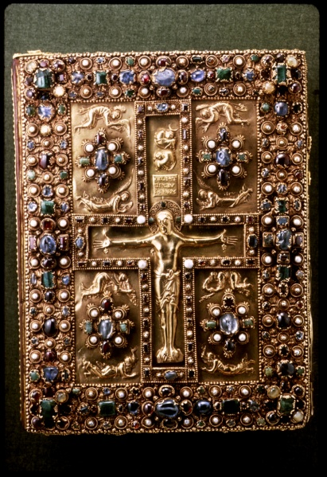
The late fourteenth century world was still very much one of the spoken word. Books were copied by hand and were a rare luxury until the advent of the printing press 70 years later. The educated elite could read, but they preferred to hear texts read out loud for entertainment. The Canterbury Tales, with their earthy humor and vivid dialogue, were a runaway success.

Slide 23
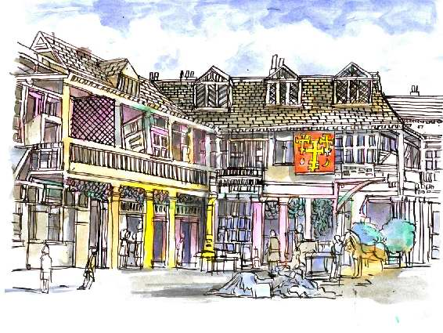
So, let’s travel back to London, to the area called Southward, and start at the Tabard Inn…

Slide 24
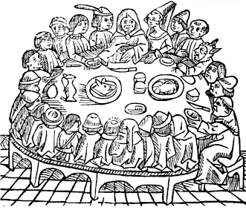
Where we meet the Innkeeper, our host, Harry Bailey

Slide 25
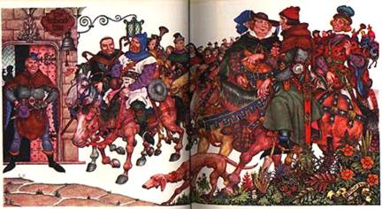
And then we meet the characters and hear their stories.

Slide 26
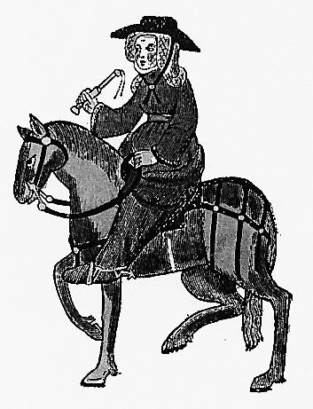
The story begins...

